Slide 1
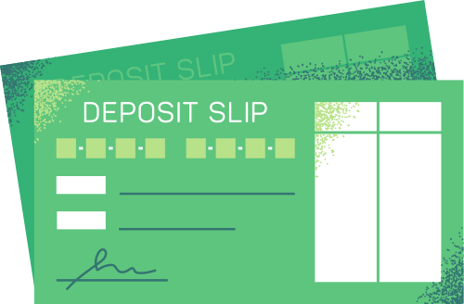
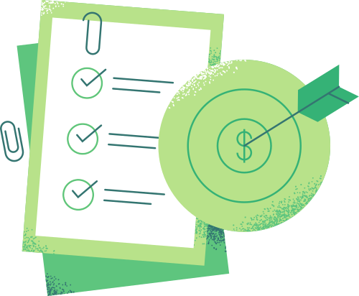





BANK CUSTOMER ATTRITION & BEHAVIOR ANALYSIS
by Aml Gamal

Slide 2



INTRODUCTION
ABOUT THE PROJECT
Analyze bank customer behavior and credit card usage
BUSINESS PROBLEM
Customer attrition leads to revenue loss
OBJECTIVES
Identify churn factors
Understand customer segments
Build interactive dashboards

Slide 3


DATASET DESCRIPTION
Bank customer dATASET
10,000 CUSTOMERS RECORDS
DEMOGRAPHICS, INCOME & CARD TYPE
TRANSACTIONS & CREDIT BEHAVIOR
TARGET: CUSTOMER ATTRITION (ACTIVE / CHURNED)
The data contains information on approximately 10,000 of the bank's customers.
This data includes personal information such as age, gender, and income, as well as details of credit cards and their transactions.
The purpose is to contact customers and identify those who may leave the bank.)

Slide 4
DATA CLEANING & PREPARATION (PYTHON)
REmoved unnECESSARY COLUMNS
REPLACED "UNKNOWN" VALUES WITH MODE FOR CATEGORICAL DATA
DETECTED AND HANDLED OUTLIERS
PREPARED DATASET FOR POWER BI DASHBOARDS
I cleaned and prepared the dataset using Python.
I removed unnecessary columns, replaced "Unknown" values with the mode for text data, and detected and handled outliers.
After that, the data was ready for analysis in Power BI.

Slide 5

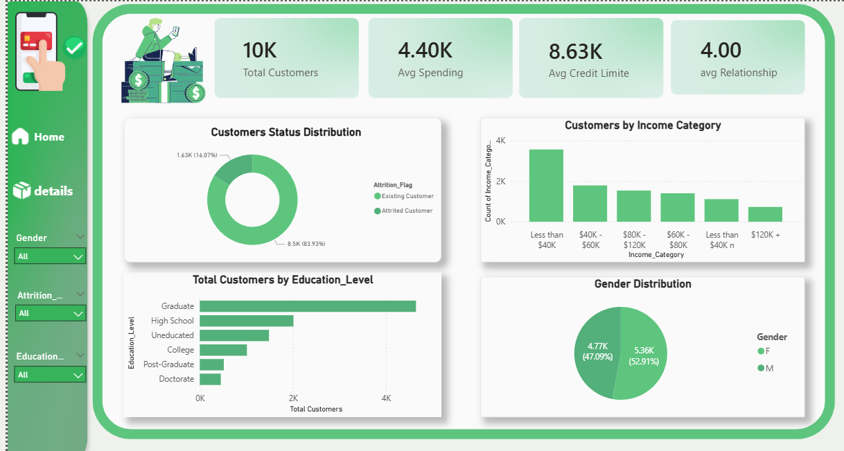
DASHBOARD OVERVIEW
This is the overview page of the dashboard.
It shows key metrics such as total customers, churn rate, average spending, and average products per customer.
The page also displays customer status and distribution by income and card type.
Interactive filters allow exploring data by gender, income, and card type.

Slide 6

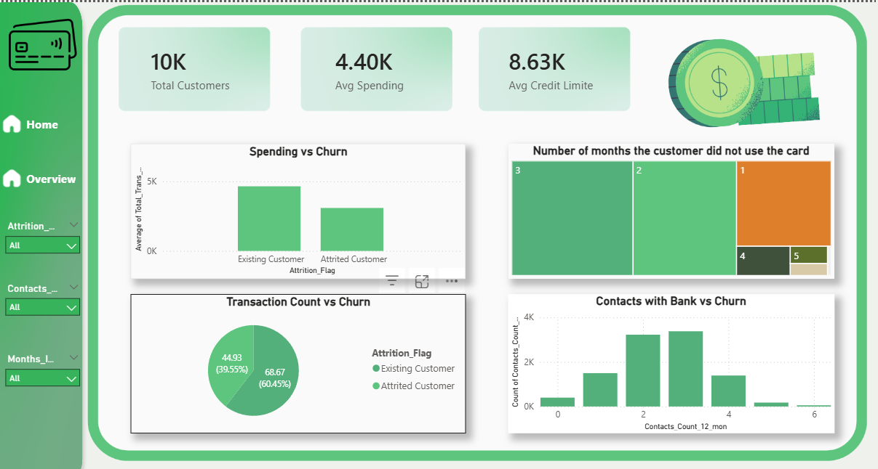
CUSTOMER BEHAVIOR DETAILS
In the Customer Behavior details page, I analyzed transactions and engagement metrics.
I looked at inactive months, total transactions, and contact counts to identify patterns that may lead to churn.
This page helps the bank better understand customer behavior and take actions to retain customers.

Slide 7
THANK YOU

